Slide 1
FitLink
PIP104 PROFESSIONAL PRACTICE-II
VIVA-VOCE
Batch Number:
Roll Number | Student Name
20201CIT0021 | Mohammed Raihaan Hussain
20201CIT0045 | Abhinay Kumar
20201CIT0133 | Shaikh Hannan
20201CIT0018 | Kaparthi Baji
20201CIT0031 | Mohammed Farhan
Under the Supervision of,
Dr. Mohana S D
Assistant Professor
School of Computer Science Engineering Presidency University

Slide 2
Introduction
The research aims to develop a novel Application Programming Interface (API) that bridges social media platforms like Facebook, LinkedIn, and WhatsApp with personal health management.
This project focuses on leveraging the immense reach of social media for promoting health and wellbeing in a community-driven approach. Social media has transformed communication and information exchange, impacting how people influence each other. Simultaneously, there is a growing interest and awareness in personal fitness and health. However, there's often a disconnect between social media use and health-related actions.
This initiative theorizes that social networks, if utilized effectively, can be powerful motivators for healthy lifestyles. The API is designed to make personal health efforts engaging and interactive, enabling users to participate in health challenges with friends and acquaintances, like achieving a certain number of steps monthly or adopting healthier eating habits.

Slide 3
Literature Review
An Incentive Mechanism Design for Socially Aware Crowdsensing Services with Incomplete Information
This literature review explores the evolving field of socially-aware crowdsensing, which integrates human participation with data collection and sharing through social networks.
This approach is gaining traction in various sectors, including healthcare and entertainment.
The review highlights the significant shift from sensor-driven systems to socially-aware services, emphasizing the influence of social network effects on user behavior.
It also discusses the critical role of incentive mechanisms in sustaining profitable crowdsensing services.
The paper delves into game theory's application in crowdsensing, specifically examining various game models like the Stackelberg game and bargaining game, and addressing challenges such as bounded rationality and incomplete social tie information.

Slide 4
2) Wearable Health Technology and Electronic Health Record Integration
This scoping review explores the integration of wearable health technology into Electronic Health Records (EHRs). The adoption of EHRs surged after the 2009 Health Information Technology Act, with policies like Meaningful Use encouraging growth. Wearable devices collect diverse patient data, and integration platforms like Apple HealthKit and Google Fit are on the rise.
Challenges include privacy concerns, interoperability, and data management.
Researchers aim for plug-and-play interoperability, using third-party apps to bridge the gap. Handling the data overload requires machine learning and user-friendly interfaces.
Innovations involve partnerships with wearable brands and insurance incentives. Future studies will continue to analyze this evolving field.

Slide 5
3) Just a Fad? Gamification in Health and Fitness Apps
This literature review addresses the growing trend of incorporating gamification elements into health and fitness apps. It highlights the significant potential of mobile technology in promoting health behavior change and emphasizes the widespread adoption of health apps.
Gamification, defined as integrating game design elements into non-game contexts, has gained popularity in this domain, aiming to enhance user engagement and sustain desired behaviors. However, empirical evidence on its effectiveness in achieving health-related outcomes is lacking.
The review draws insights from an analysis of 132 health and fitness apps, revealing prevalent gamification components like leaderboards and social pressure. It also underscores the absence of industry standards in gamification, raising concerns about its impact on behavior change effectiveness. Future research should focus on evaluating gamification's efficacy and establishing guidelines for developers and health practitioners.

Slide 6
4) Integrating Health and Fitness Data from Wearable Devices
This literature review explores the landscape of wearable devices, focusing on fitness trackers as cost-effective health monitoring tools. Approximately 50% of individuals in developed countries use wearables, but data heterogeneity across devices hinders effective data sharing and integration.
To address this, the review proposes a virtual integration approach using RDF graphs to convert heterogeneous IoT data into structured formats, improving scalability and interoperability. It also highlights the importance of assessing the validity and reliability of fitness trackers, especially in medical applications.
Semantic Web technologies and the RDF Mapping Language (RML) are examined for their role in data integration.
The review concludes by emphasizing the potential of self-tracked health data and the need for collaboration to advance medical applications, particularly in fields like oncology. Funding sources and acknowledgments are also noted.

Slide 7
5) Harnessing Social Media for Health Promotion and Behavior Change
This literature review explores the utilization of social media as a dynamic platform for health promotion. It delves into the various types of social media employed in this context, emphasizing their potential to engage diverse audiences and empower individuals in health-related interactions.
The review acknowledges that a significant portion of the population, spanning various demographics, seeks health information online, with social media platforms being valuable resources for health information seekers. Research indicates that social media interventions can positively impact health knowledge and behavior, especially when driven by behavior change theories.
Customizing messages, adapting content, and robustly evaluating interventions are key strategies for success. However, challenges like information overload and sustaining user engagement persist, emphasizing the need for ongoing research to optimize the role of social media in health promotion.

Slide 8
Research Gaps Identified
Socially-Aware Crowdsensing
Research Gap: in this area lies in the lack of a comprehensive exploration of security considerations within incentive mechanisms for socially-aware crowdsensing.
Future Research Opportunities: include practical implementation and validation of the Bayesian game-theoretic model for optimizing strategies.

Slide 9
2) Wearable Health Technology
Research Gap: exist in understanding evolving best practices, challenges, and solutions in data movement from patients to providers using wearable health technology.
Future Research Opportunities: should delve deeper into this field, exploring emerging challenges and innovative solutions.

Slide 10
3) Web-Based Technologies in Infectious Disease Surveillance
Research Gap: Addressing the challenges related to data accuracy and privacy concerns in utilizing web-based intelligence for infectious disease surveillance.
Future Research Opportunities: Ongoing exploration needed to refine methodologies and enhance the participatory approach in public health initiatives using web-based technologies.

Slide 11
4) Gamification in Health and Fitness Apps
Research Gap: Limited research on the efficacy of gamification in achieving health behavior change outcomes.
Future Research Opportunities: The need for industry standards to guide developers and health practitioners in the design and implementation of gamified features in health and fitness apps.

Slide 12
5) Social Media in Health Promotion
Research Gap: In-depth exploration needed on user behaviors, motivations, and the cost-effectiveness of social media interventions.
Future Research Opportunities: Continued research to refine strategies and optimize the potential of social media platforms for health promotion and behavior change.

Slide 13
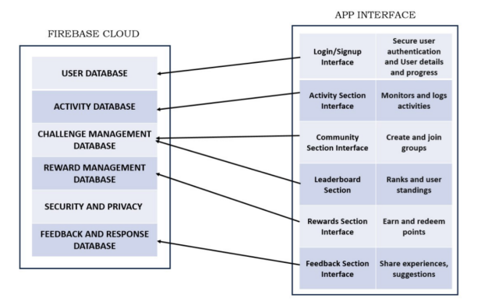
Proposed Design

Slide 14
Proposed Methodology
Create Account
Create Workout Plans
Create Groups
Classification
Display Leaderboards

Slide 15
Objectives
Develop a User-Friendly Interface
Integrate Social Networking Capabilities
Implement Personalized Fitness Tracking
Incorporate Gamification Elements
Promote Community Building
Ensure Data Privacy and Security
EnableGoalSettingandMonitoring
SupportMulti-PlatformAccessibility
FacilitateUserFeedbackandImprovement
OfferDiverseExerciseRoutines

Slide 16
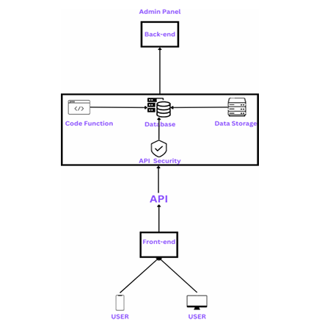
System Design & Implementation
APPLICATION ARCHITECTURE

Slide 17
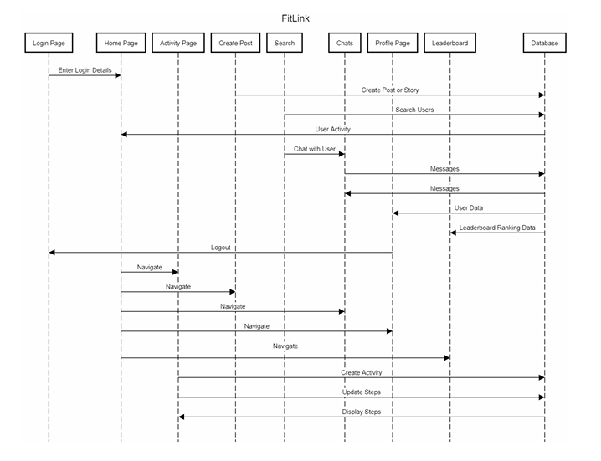
System Design & Implementation
SEQUENCE DIAGRAM

Slide 18
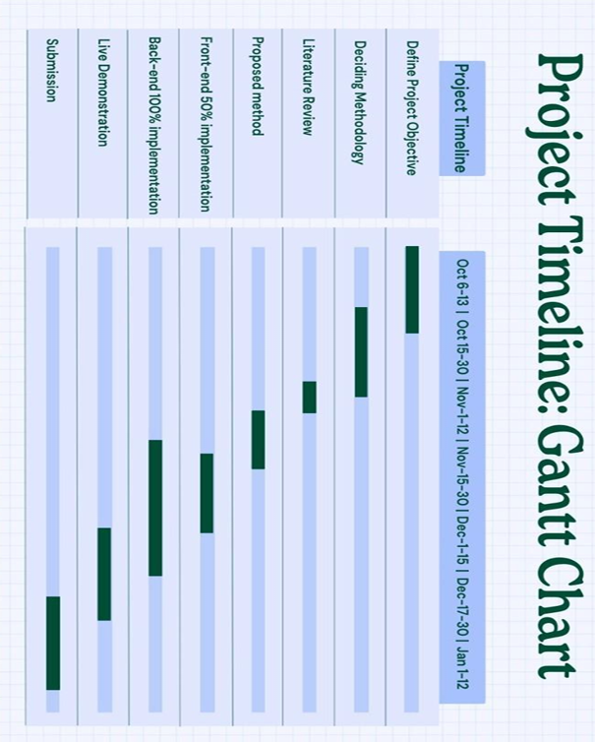
Timeline of Project

Slide 19
Outcomes / Results Obtained
Develop a User-Friendly Interface
Integrate Social Networking Capabilities
Implement Personalized Fitness Tracking
Incorporate Gamification Elements
Promote Community Building
Ensure Data Privacy and Security
Enable Goal Setting and Monitoring
Support Multi-Platform Accessibility
Facilitate UserFeedback and Improvement
Offer Diverse Exercise Routines

Slide 20
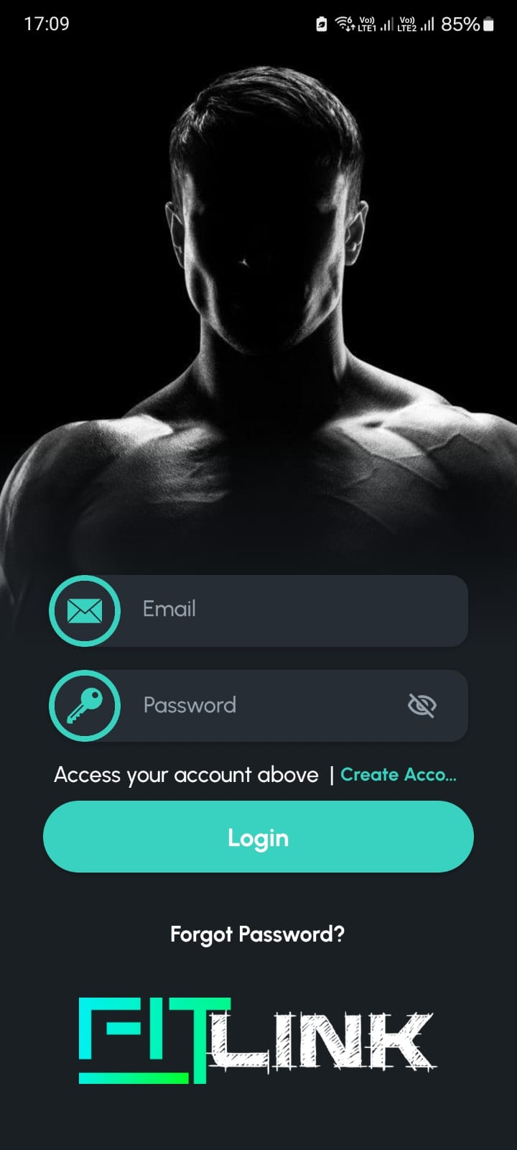

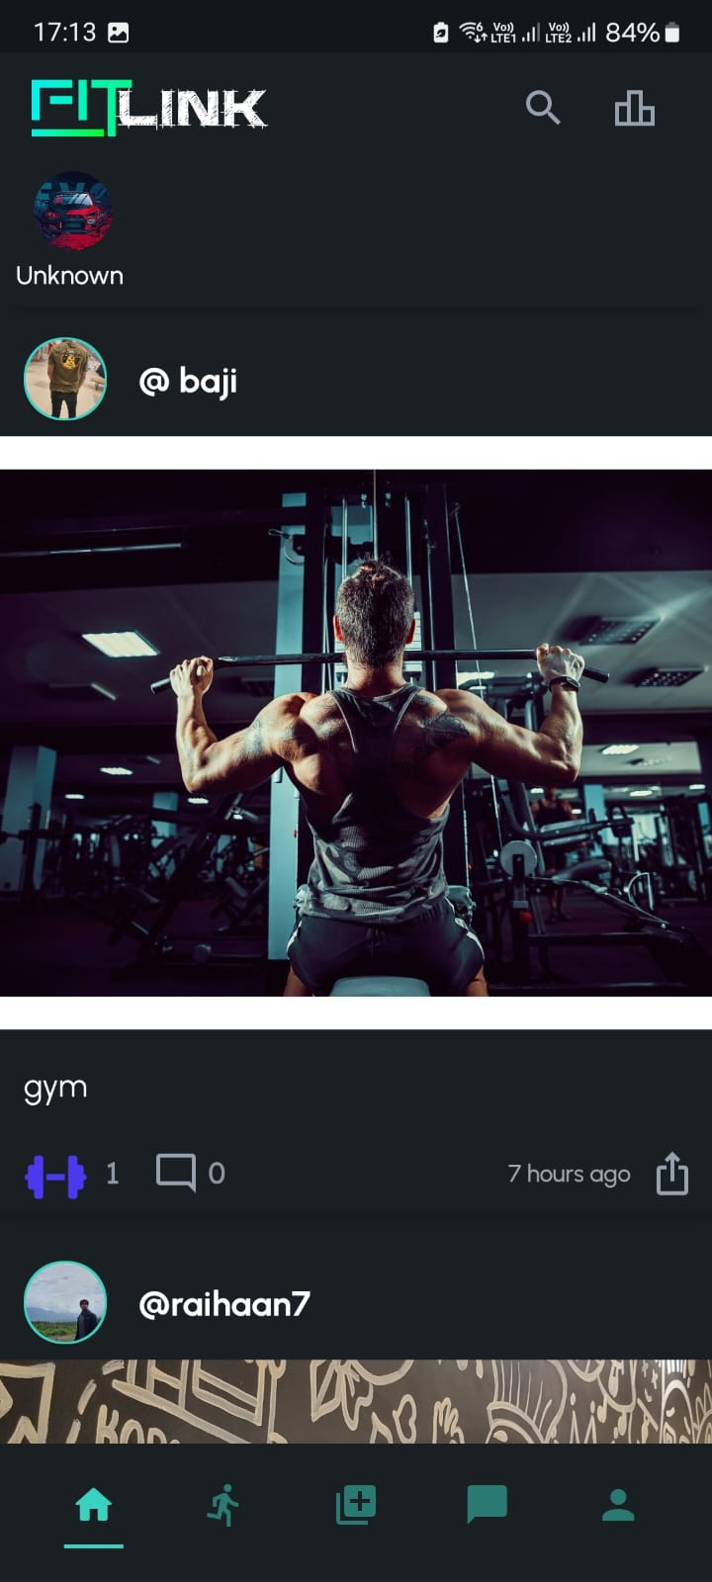

Results (SCREENSHOTS)
HOME PAGE
CREATE ACCOUNT PAGE
HOMEPAGE
POST DETAILS

Slide 21


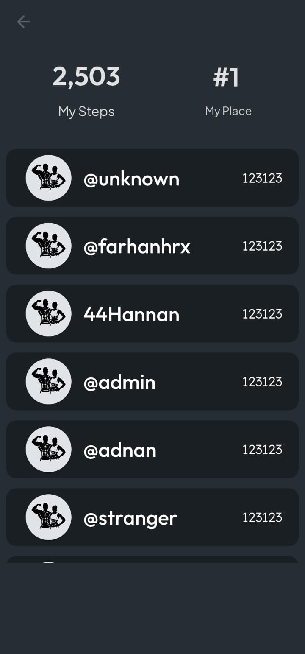
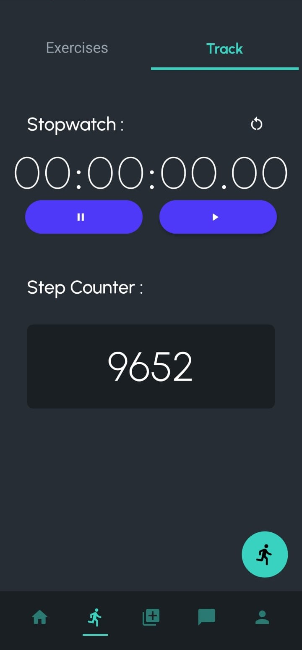

Results (SCREENSHOTS)
CREATE POST OR STORY PAGE
CHAT PAGE
LEADERBOARDS PAGE
ACTIVITY PAGE
EXERCISE PAGE

Slide 22
Conclusion
Successful Integration of Social Connectivity
Increased User Engagement and Retention
Positive Impact on Fitness Goals Achievement
High User Satisfaction
Importance of User-Centric Design
Pioneering Model in Digital Health
Future Development Opportunities
Adapting to Technological Advancements

Slide 23
References
Nie, J., Luo, J., Xiong, Z., Niyato, D., Wang, P., & Guizani, M. (2019). An incentive mechanism designed for socially aware crowdsensing services with incomplete information. IEEE Communications Magazine, 57(4), 74-80.
Dinh-Le, C., Chuang, R., Chokshi, S., & Mann, D. (2019). Wearable health technology and electronic health record integration: scoping review and future directions. JMIR mHealth and uHealth, 7(9), e12861
Lister, C., West, J. H., Cannon, B., Sax, T., & Brodegard, D. (2014). Just a fad? Gamification in health and fitness apps. JMIR serious games, 2(2), e3413
Reda, R., Piccinini, F., Martinelli, G., & Carbonaro, A. (2022). Heterogeneous self-tracked health and fitness data integration and sharing according to a linked open data approach. Computing, 104(4), 835-857
Korda, H., & Itani, Z. (2013). Harnessing social media for health promotion and behavior change. Health promotion practice, 14(1), 15-23.
Yang, Y. T., Horneffer, M., & DiLisio, N. (2013). Mining social media and web searches for disease detection. Journal of public health research, 2(1), jphr-2013

Slide 24
References
Tong, H. L., Coiera, E., Tong, W., Wang, Y., Quiroz, J. C., Martin, P., & Laranjo, L. (2019). Efficacy of a mobile social networking intervention in promoting physical activity: Quasi-experimental study. JMIR mHealth and uHealth, 7(3), e12181.
Mazeas, A., Duclos, M., Pereira, B., & Chalabaev, A. (2022). Evaluating the effectiveness of gamification on physical activity: systematic review and meta-analysis of randomized controlled trials. Journal of medical Internet research, 24(1), e26779.
Milne-Ives, M., Lam, C., Van Velthoven, M. H., & Meinert, E. (2020). Mobile apps for health behavior change: Protocol for a systematic review. JMIR research protocols, 9(1), e16931 School of Computer Science Engineering & Information Science, Presidency University. 40 FitLink
Laranjo, L., Arguel, A., Neves, A. L., Gallagher, A. M., Kaplan, R., Mortimer, N., ... & Lau, A. Y. (2015). The influence of social networking sites on health behavior change: a systematic review and meta-analysis. Journal of the American Medical Informatics Association, 22(1), 243-256.
Löfblom, J. (2017). Defining user experience principles for developing health and fitness wearables and smartwatches.

Slide 25
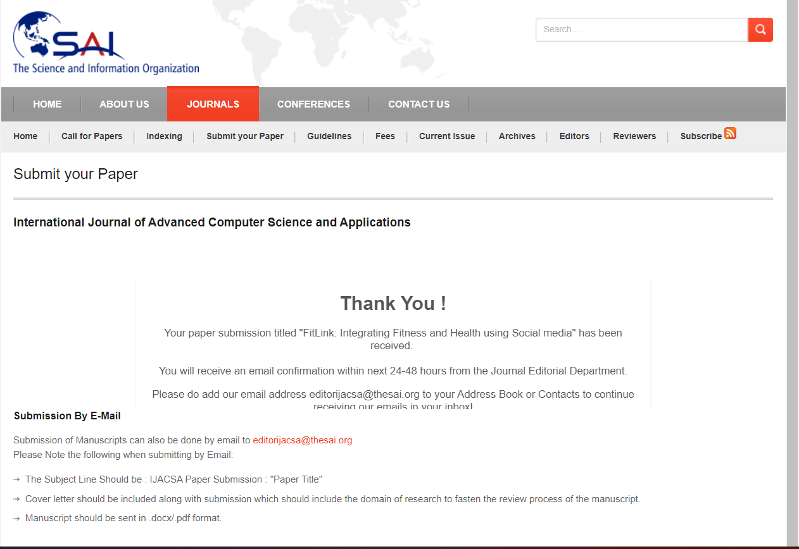
Publication Details

Slide 26

Thank You

